Slide 1
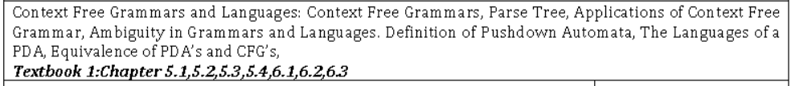

Slide 2
Context Free Grammars and Languages:
Context Free Grammars,
Parse Tree,
Applications of Context Free Grammar,
Ambiguity in Grammars and Languages.
Definition of Pushdown Automata,
The Languages of aPDA,
Equivalence of PDA’s and CFG’s,

Slide 3
Context Free Grammars

Slide 4
In formal language theory, a grammar is typically represented using a tuple, especially when defining context-free grammars (CFGs). The standard notation for a grammar is represented as a 4-tuple:
G=(V,T,P,S)
Where:
V (Variables or Non-terminals): A finite set of non-terminal symbols. These symbols can be replaced or expanded using production rules. They are also referred to as syntactic variables.
T (Terminals): A finite set of terminal symbols, which form the actual content of the strings generated by the grammar. Terminal symbols are the alphabet of the language and appear in the final output strings.
P (Productions or Rules): A finite set of production rules. Each rule is of the form: A→α
Where:
A is a non-terminal symbol from V.
α is a string of symbols from (V∪T) (i.e., a combination of terminals and/or non-terminals).
S (Start Symbol): A special non-terminal symbol from VVV that denotes the starting point for generating strings. It is the symbol from which production begins.

Slide 5
Consider a simple grammar G defined as:
G=(V,T,P,S) With the following components:
V={S,A} (Set of non-terminals)
T={a,b} (Set of terminals)
P={S→aA,A→b} (Set of productions)
S (Start symbol)
This grammar generates strings starting with a and followed by b.

Slide 6
P- Production Rules Represented
LHS----------------------------------------> RHS
Single Non Terminal----------------→ E | String of terminal & Non terminals.
A---------------→ aB
B--------------→E
________________________________________________________________________ A---------------→ aB c
B--------------→E
C-------------→b

Slide 7
REGULAR GRAMMER
A Regular Grammar is a formal grammar that is used to generate regular languages. It is a subset of context-free grammars and consists of rules that have specific constraints. Regular grammars are closely related to Regular Expressions and Finite Automata, making them useful for defining patterns in lexical analysis, programming languages, and text processing.
Types of Regular Grammars
There are two main types of regular grammars:
Right-Linear Grammar
Left-Linear Grammar

Slide 8
1. Right-Linear Grammar
In a Right-Linear Grammar, each production rule must satisfy one of the following forms:
A → aB
A → a
A → ε
Where:
A and B are non-terminal symbols.
a is a terminal symbol.
ε is the empty string (used to denote termination or end of string).

Slide 9
2. Left-Linear Grammar
In a Left-Linear Grammar, each production rule must satisfy one of the following forms:
A → Ba
A → a
A → ε
Where:
A and B are non-terminal symbols.
a is a terminal symbol.
ε is the empty string.

Slide 10
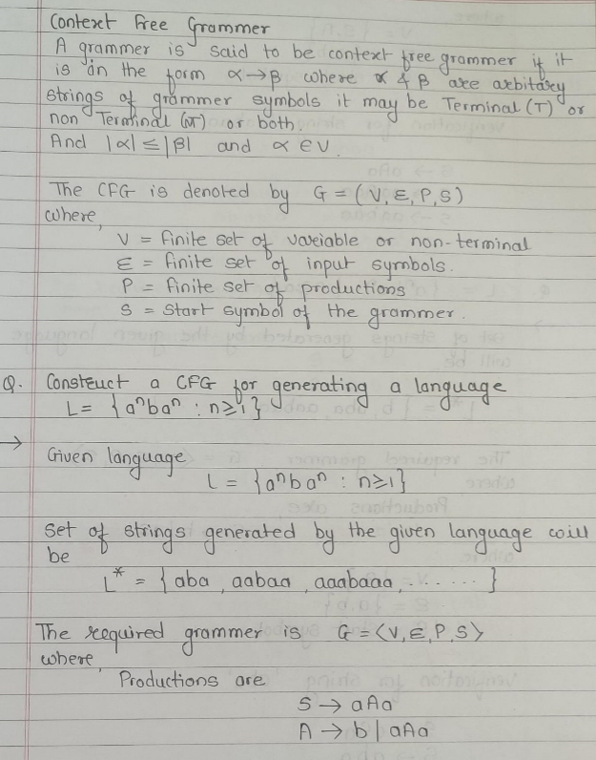

Slide 11
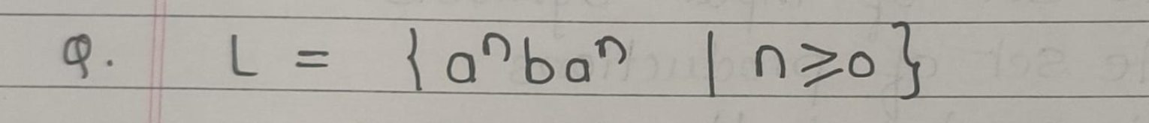

Slide 12
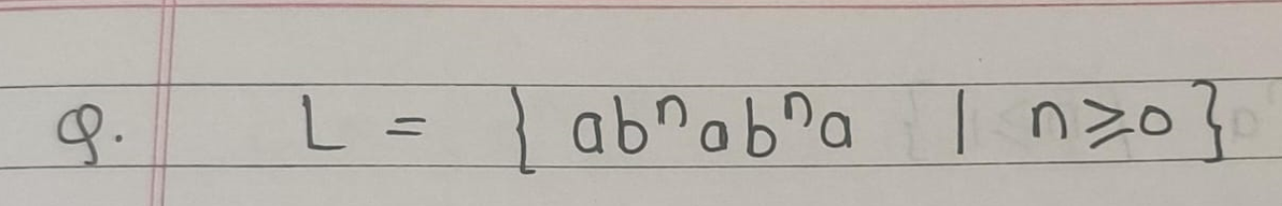

Slide 13
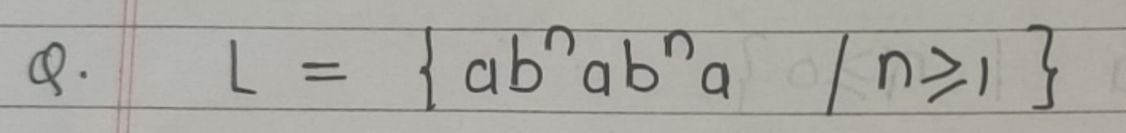

Slide 14
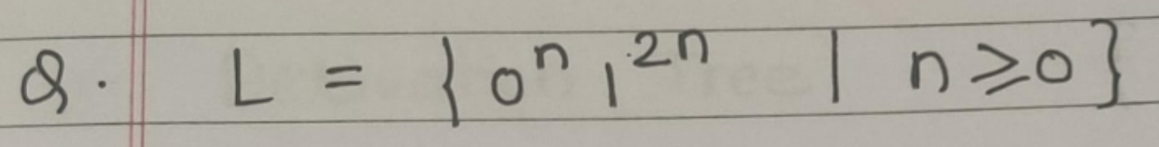

Slide 15
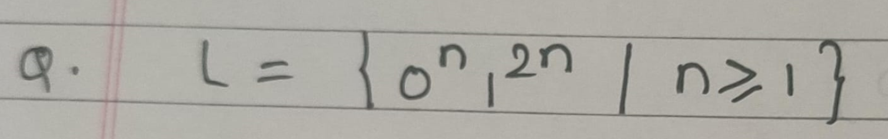

Slide 16
Derivation Tree/ parse Tree
A derivation tree, also known as a parse tree, is a tree representation of the syntactic structure of a string derived from a grammar. It is commonly used in the context of formal languages and automata theory, especially when parsing languages defined by context-free grammars (CFGs). Here's a breakdown of its components and purpose:

Slide 17
Rightmost derivation and leftmost derivation are two types of derivations in context-free grammar, used to produce a string from the start symbol by applying production rules. They differ in the order in which non-terminal symbols are replaced during each step of the derivation process.

Slide 18
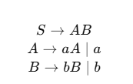
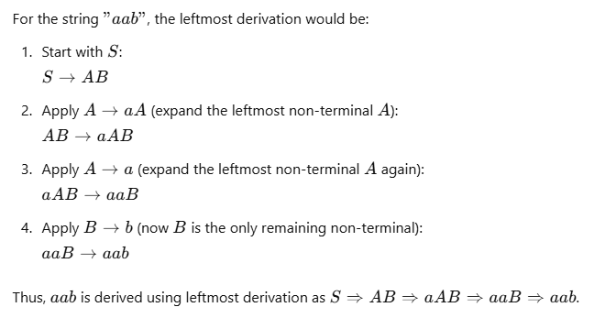
1. Leftmost Derivation
In a leftmost derivation, at each step, the leftmost non-terminal is replaced first according to the production rules. This means that if a string contains multiple non-terminals, you always expand the one farthest to the left before expanding any others.
Example
S
/ \
A B
/ \
a b
\
A
\
a

Slide 19
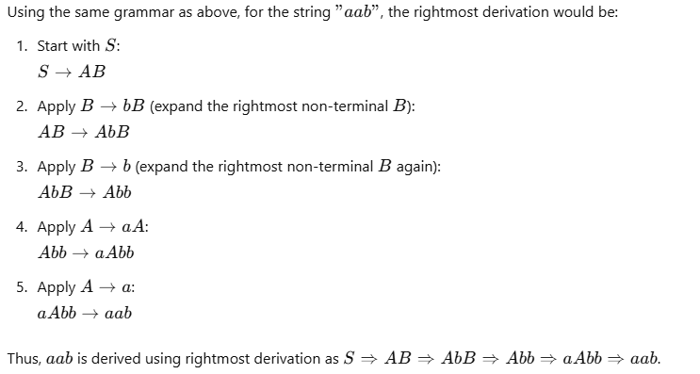
2. Rightmost Derivation
In a rightmost derivation, at each step, the rightmost non-terminal is replaced first. This means that if a string contains multiple non-terminals, you always expand the one farthest to the right before expanding any others.
Example
S
/ \
A B
/ \
a b
\
A
\
a

Slide 20
Key Points
Leftmost derivation: Always expand the leftmost non-terminal.
Rightmost derivation: Always expand the rightmost non-terminal.
Both derivations will produce the same final string but differ in the order of rule applications.
Derivation trees can be constructed from both types of derivations and will look the same regardless of the derivation type; only the order of applying rules differs.

Slide 21
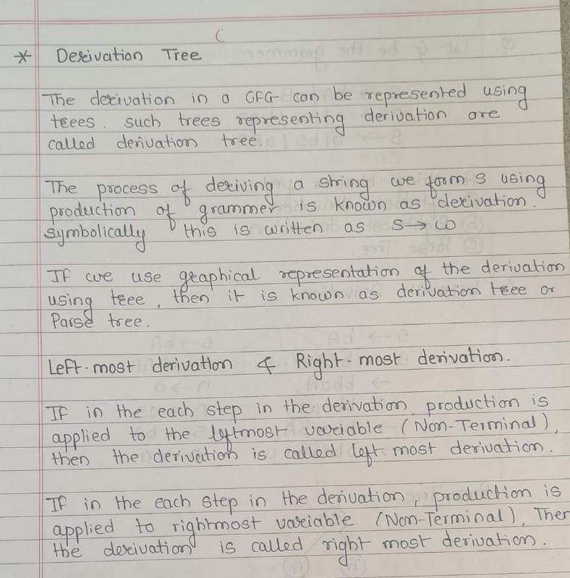

Slide 22
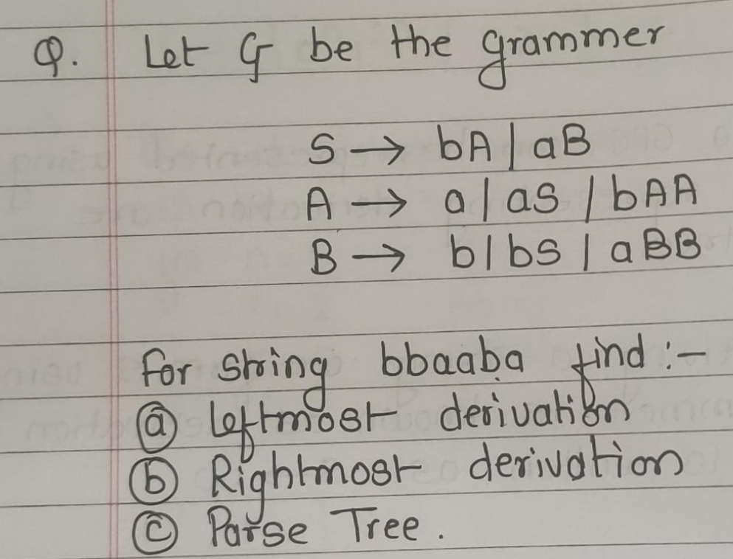

Slide 23
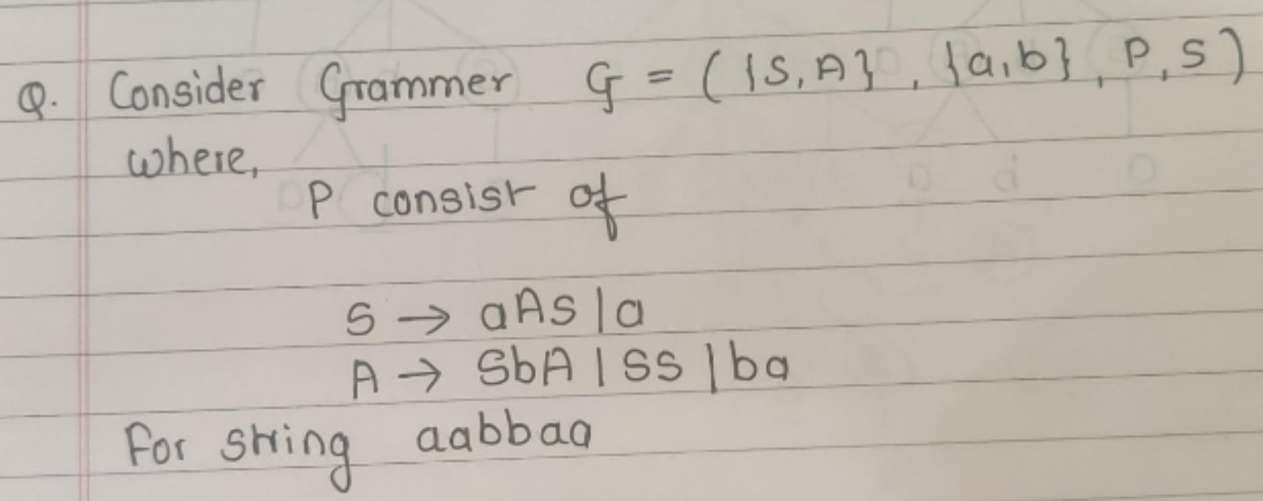

Slide 24
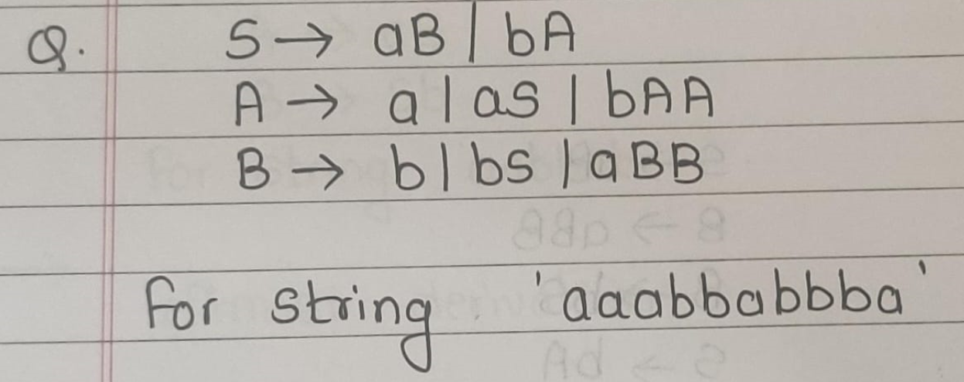

Slide 25
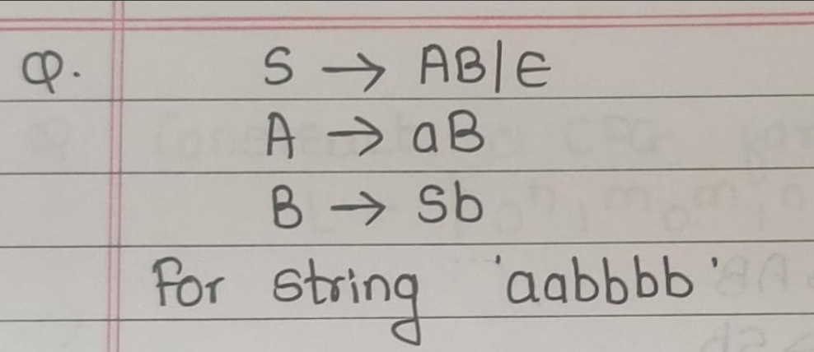

Slide 26
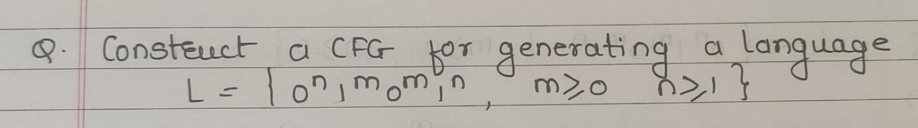

Slide 27
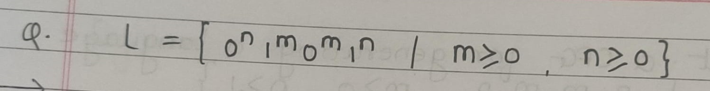

Slide 28
Applications of Context Free Grammar
CFGs are fundamental tools for defining and analyzing structured languages, from programming languages to human languages and complex workflows. Their versatility and expressive power make them essential in applications that involve parsing, structure validation, and syntax analysis across many fields.

Slide 29
Context-Free Grammars (CFGs) have a wide range of applications, particularly in fields related to computer science, linguistics, and formal language theory. Here are some of the main applications:
Programming Language Design and Compilation
Syntax Definition: CFGs are used to define the syntax of programming languages. Each programming language has specific rules about how code must be structured, and these rules can often be described using a CFG. For example, constructs like expressions, statements, loops, and function definitions are defined by grammar rules.
Parsing: During compilation, a parser uses the grammar to generate a parse tree for code. This helps compilers understand the structure of code and convert it into machine language or intermediate code.
Error Checking: By analyzing code through CFGs, compilers can detect syntax errors and give feedback to programmers.

Slide 30
Natural Language Processing (NLP)
Syntactic Analysis: CFGs are used in NLP to analyze and understand the syntactic structure of human languages. They help break down sentences into parts of speech (e.g., nouns, verbs) and phrase structures (e.g., noun phrases, verb phrases).
Parsing Sentences: CFGs can be applied to parse sentences, identifying relationships between words to understand meaning and context, which is useful in tasks like machine translation, speech recognition, and sentiment analysis.
Grammatical Correctness: In language-based applications like grammar checkers, CFGs can be used to check if sentences follow correct grammar rules.

Slide 31
XML and HTML Document Structure
Validation of Document Structure: CFGs are used to define the structure of XML and HTML documents. DTDs (Document Type Definitions) and XML Schemas use similar concepts to ensure that documents follow a predefined structure.
Parsing XML and HTML: Web browsers and XML parsers use CFGs to interpret and render structured documents correctly.

Slide 32
Modeling and Designing Formal Systems
Formal Language Theory: CFGs are used to study the formal properties of languages, including theoretical studies of automata and language hierarchies.
Finite State Machines and Automata: CFGs are foundational in constructing models for automata and other theoretical machines, which have applications in language processing and computation theory.

Slide 33
Artificial Intelligence and Machine Learning
Natural Language Understanding in AI: CFGs help AI systems process human languages by providing a structure to interpret complex sentences, especially in areas like chatbots and virtual assistants.
Knowledge Representation: CFGs assist in structuring rules for knowledge bases, such as representing hierarchical or nested information, which can be used by reasoning engines.

Slide 34
Bioinformatics
RNA and Protein Structure Prediction: In bioinformatics, CFGs are applied to predict the structure of biological molecules. They can represent the nested structure of RNA and protein sequences, aiding in understanding biological patterns.
Gene Sequence Analysis: Certain biological structures, such as palindromic sequences in DNA, can be represented by CFGs to help in gene identification and other analyses.

Slide 35
Game Development
Procedural Content Generation: CFGs are used in games to create procedural narratives or worlds. For instance, they help generate dialogue trees, quest structures, or complex branching storylines that can adapt to player choices.
Dialogue Systems: In interactive games, CFGs help in building dialogue systems that respond based on structured grammar rules.

Slide 36
Robotic Process Automation (RPA) and Workflow Systems
Defining Workflow Rules: CFGs can be used to specify rules and sequences in workflows for automation, helping systems to parse and execute complex workflows according to predefined rules.
Command Interpretation: Robots or automated systems can interpret and act on structured commands using grammars to understand and execute instructions.

Slide 37
Mathematics and Logic
Mathematical Expression Parsing: CFGs are used to parse mathematical expressions and equations, which is crucial in symbolic computation, computer algebra systems, and tools for mathematical problem-solving.
Proof Verification: In formal logic, CFGs can help structure proofs, allowing automated systems to verify the correctness of logical arguments.

Slide 38
Ambiguity in Grammars and Languages
Ambiguity in grammars and languages is a situation where a given grammar generates a string that can have more than one distinct parse tree or derivation. This can lead to confusion in interpreting the structure and meaning of the string. Ambiguity is particularly significant in programming languages, compilers, and natural language processing, where consistent interpretation is critical.
Ambiguity in grammars leads to multiple interpretations of the same string, which is often undesirable in computational contexts like programming languages. By refining grammars or limiting language constructs, ambiguity can be minimized to ensure a consistent and clear structure.

Slide 39
What Is an Ambiguous Grammar?
A grammar is ambiguous if there exists at least one string in the language that has multiple valid parse trees (or equivalently, multiple leftmost or rightmost derivations) according to the grammar. This means that there is more than one way to derive the same string, leading to multiple interpretations of the structure.

Slide 40
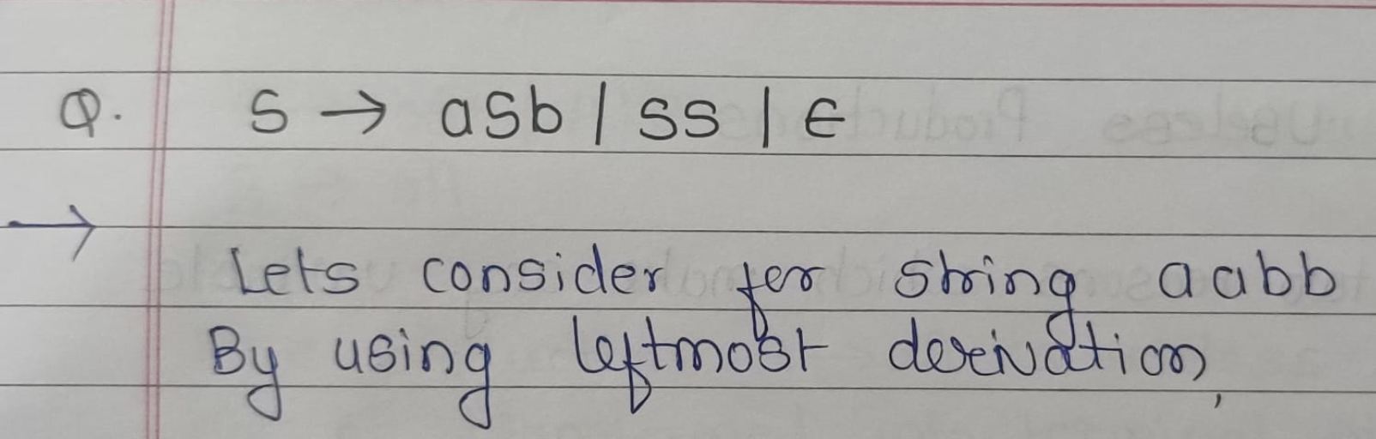

Slide 41
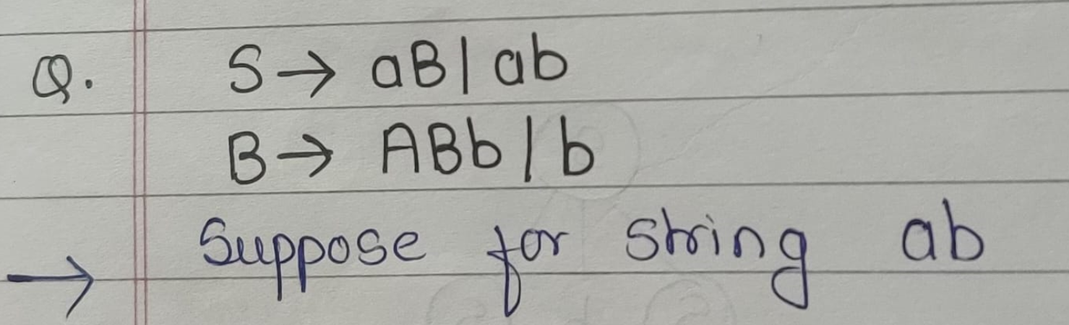

Slide 42
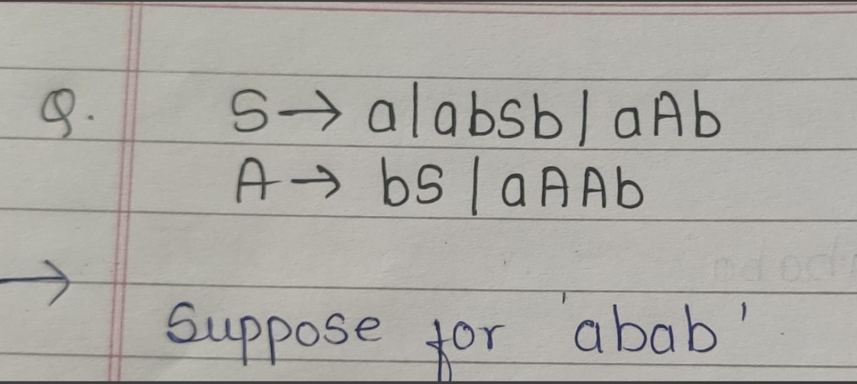

Slide 43
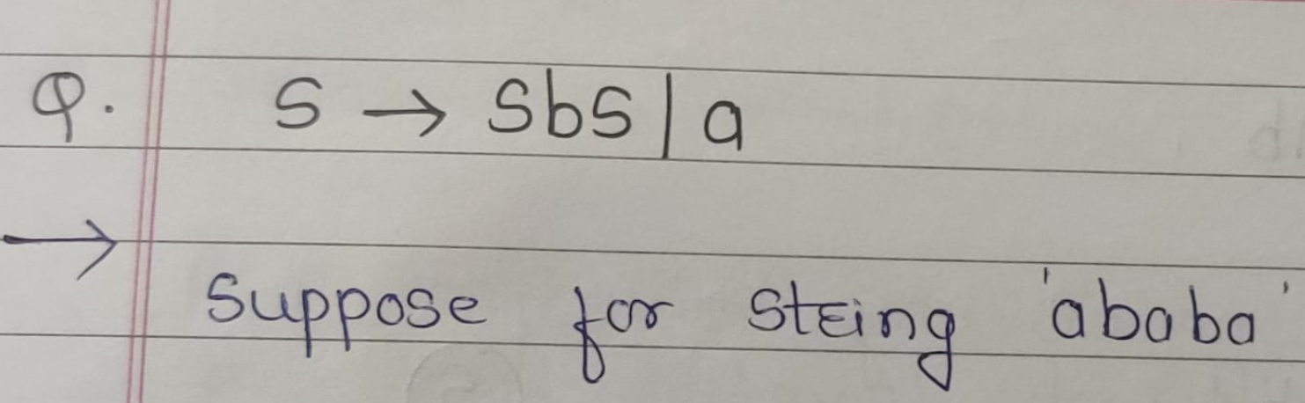

Slide 44
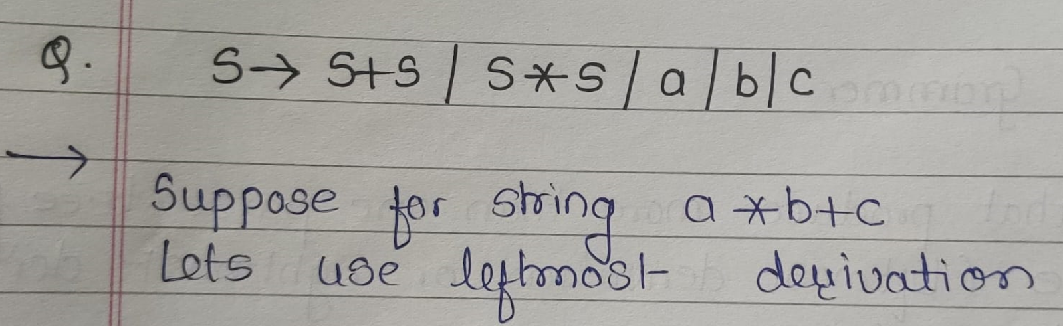

Slide 45
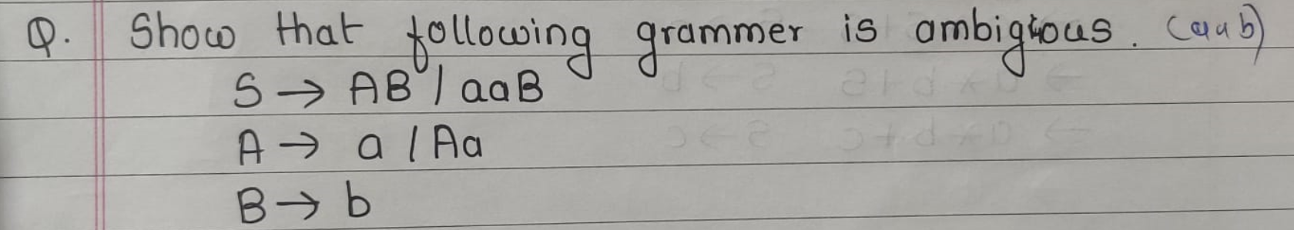

Slide 46
Removing Useless Productions
In the context of formal grammars, removing useless productions is an essential process for simplifying a grammar. This step is crucial, especially when dealing with ambiguous grammars, as it helps streamline the grammar by eliminating rules that do not contribute to deriving terminal strings. Useless productions are productions that can never be part of any derivation of a string in the language generated by the grammar.

Slide 47
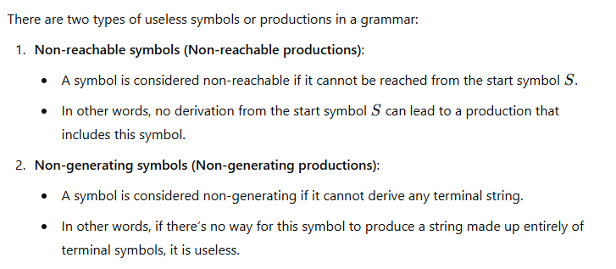

Slide 48
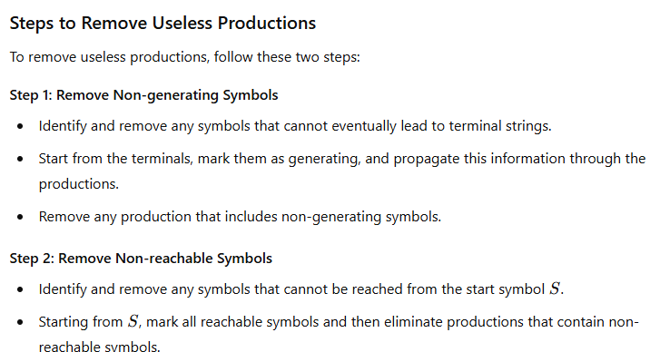

Slide 49
Derivability (A Variable which generate string)
Reachability (A Variable which is reachable from starting S)
Useful Symbol: {a,b,S,A}

Slide 50
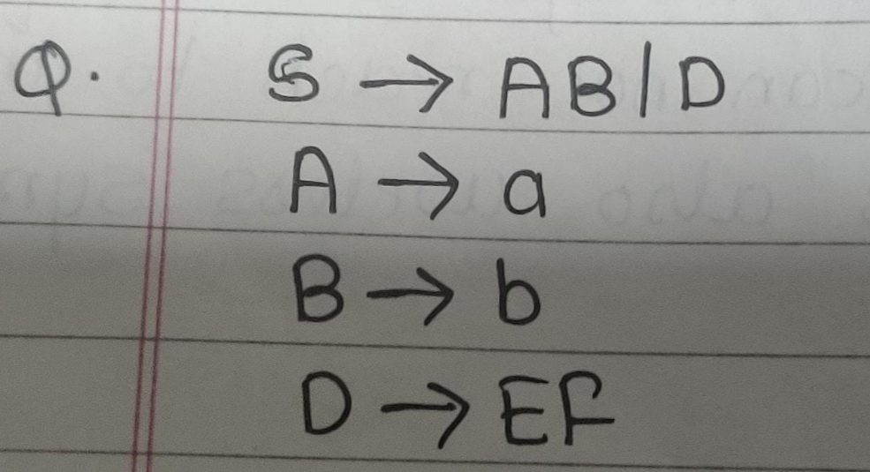
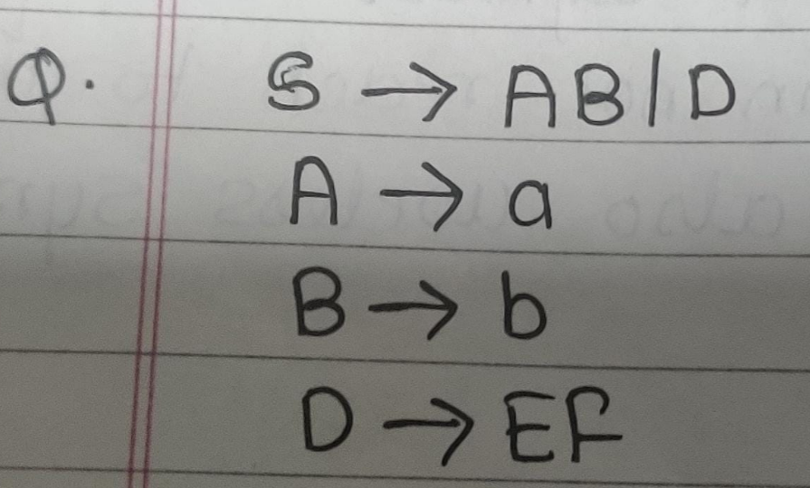
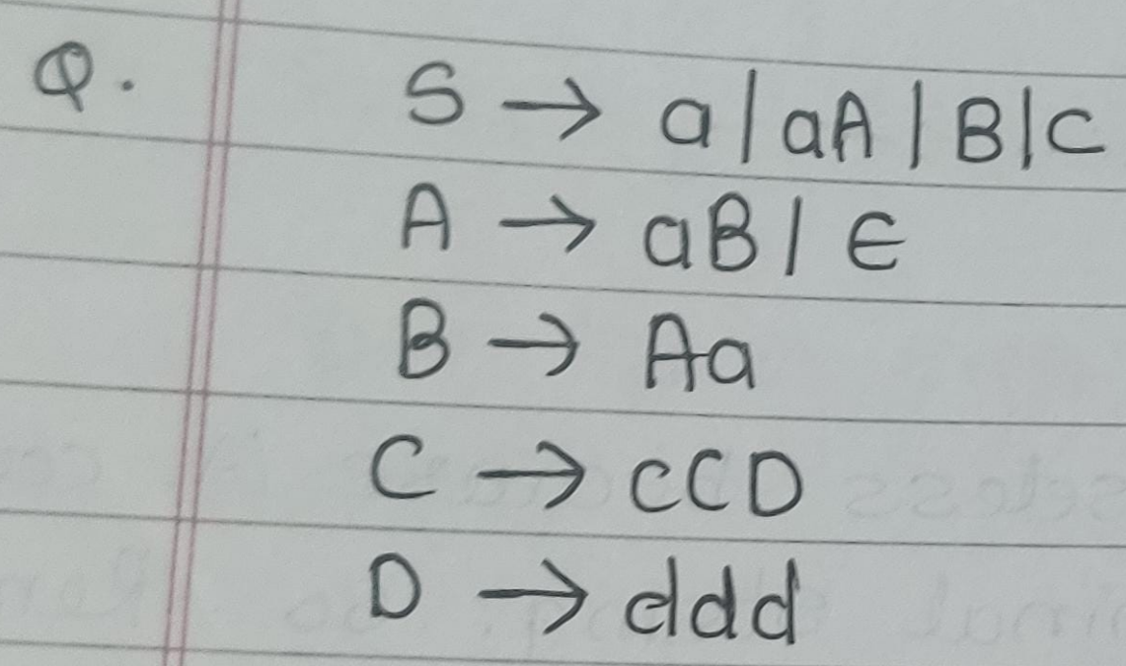
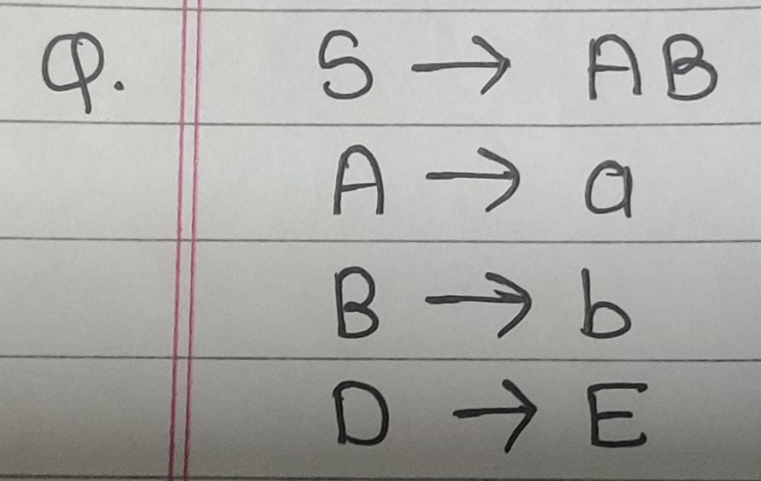

Slide 51
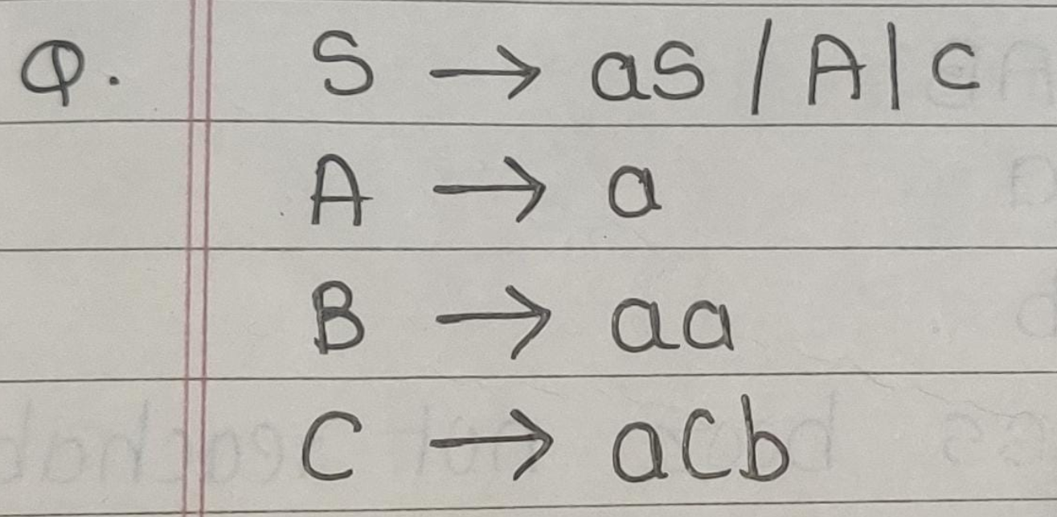
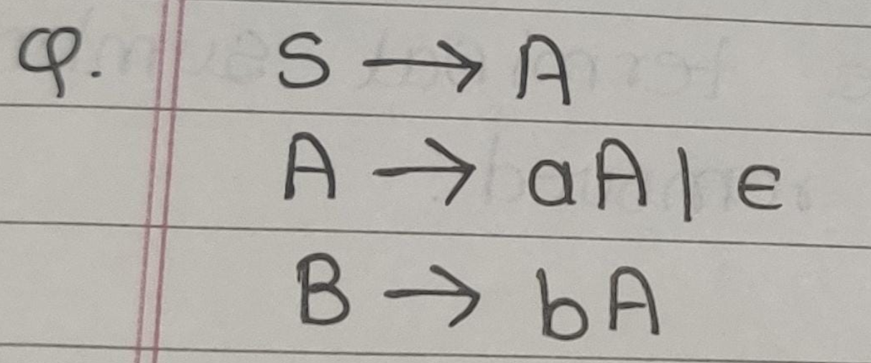
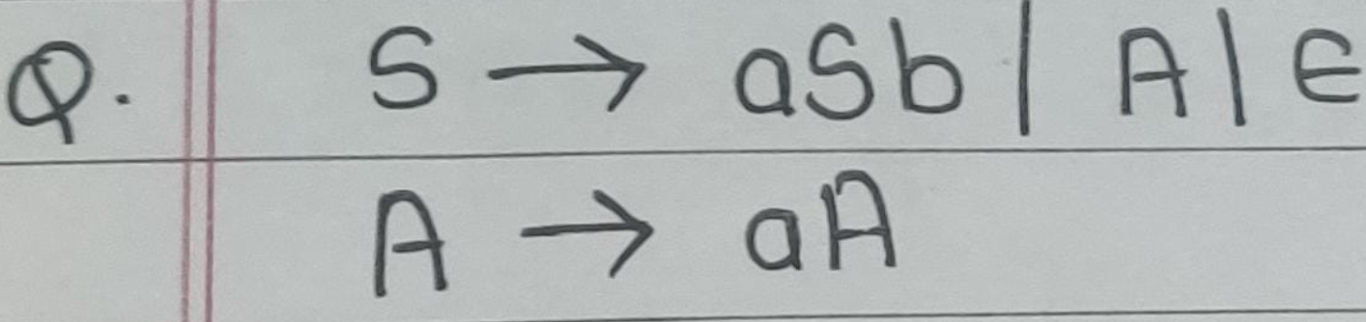
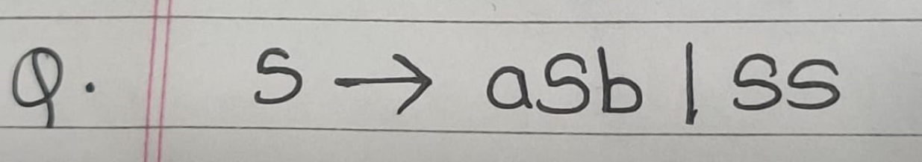

Slide 52
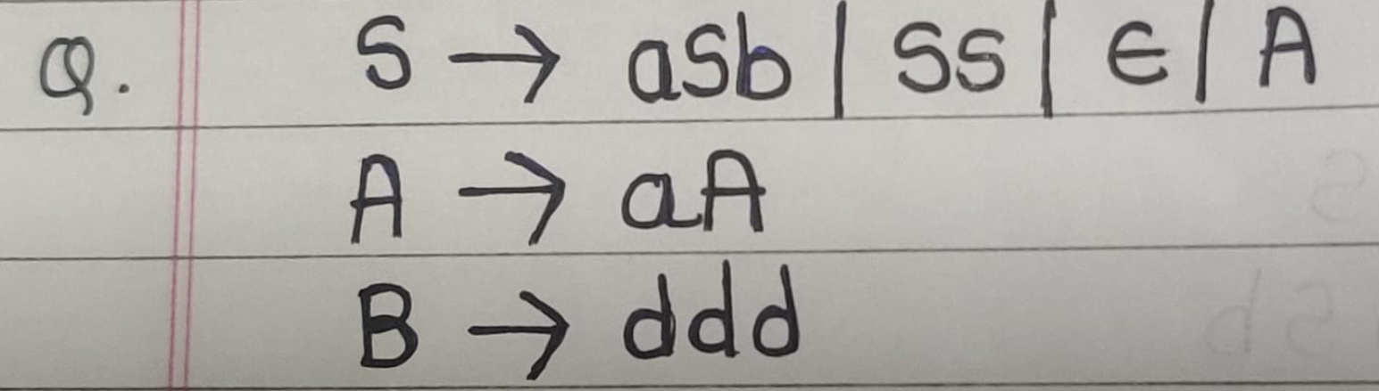

Slide 53
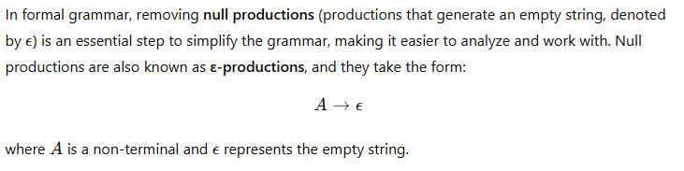
Removing E (Null Production)

Slide 54
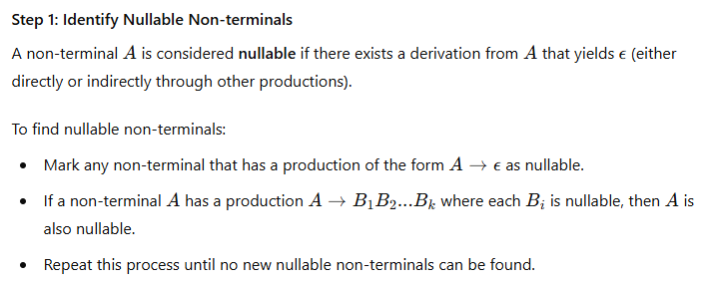
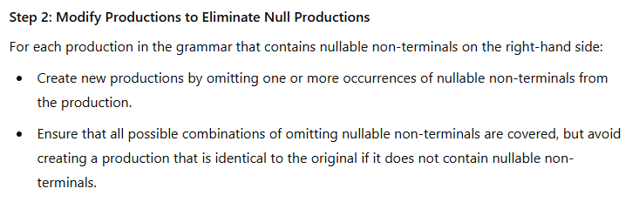
Steps to Remove Null Productions
To eliminate null productions while preserving the language generated by the grammar (except possibly removing the empty string if it’s part of the language), follow these steps:

Slide 55
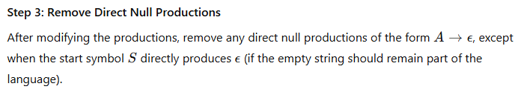

Slide 56
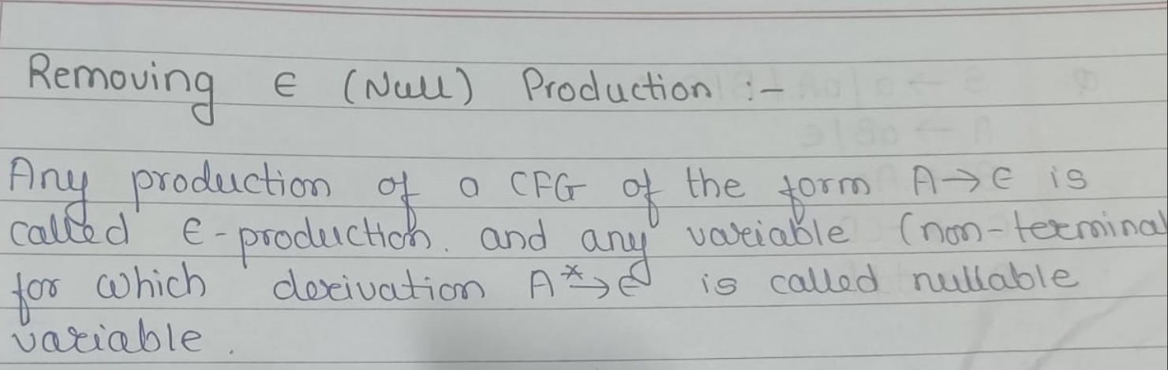

Slide 57
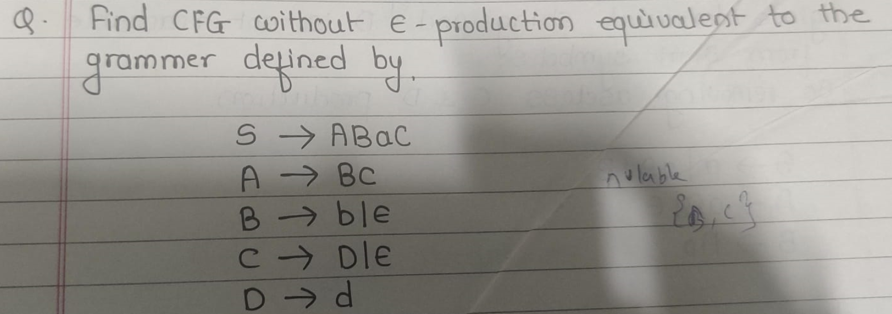

Slide 58
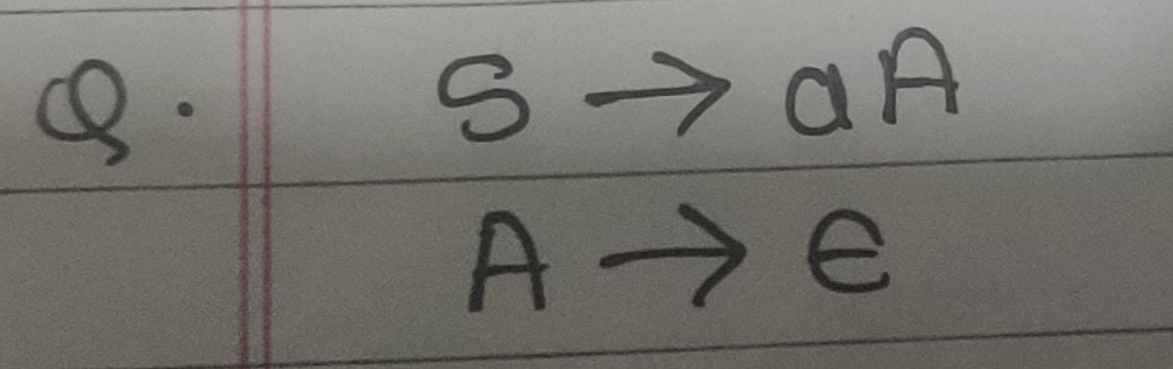

Slide 59
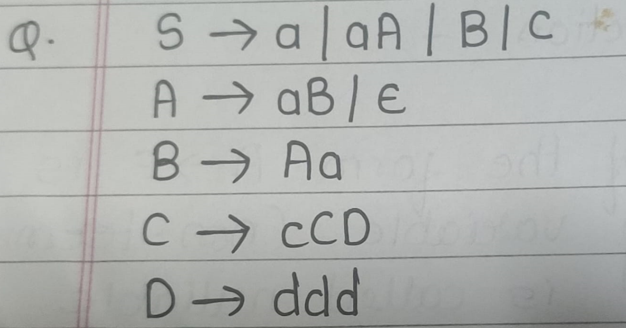

Slide 60
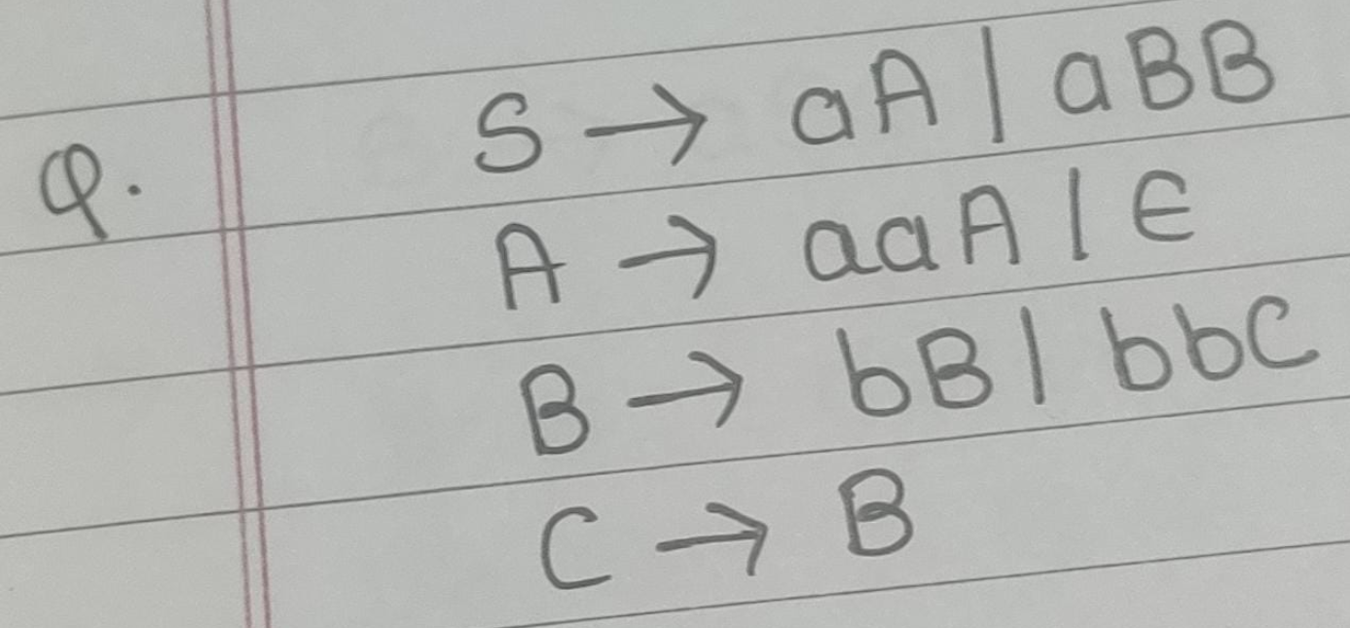

Slide 61
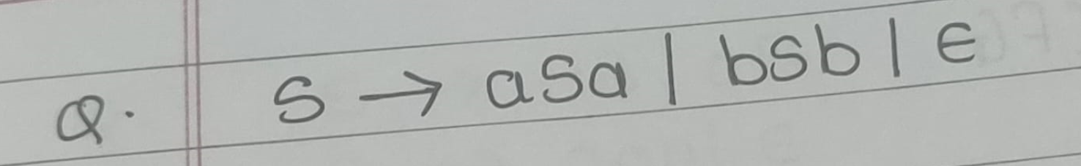

Slide 62
PUSH DOWN AUTOMATA
A Pushdown Automaton (PDA) is a type of computational model used to recognize context-free languages. It is an extension of the finite automaton with an additional feature: a stack. The stack provides extra memory that allows the PDA to handle a broader class of languages than finite automata, including languages with nested or recursive structures (like balanced parentheses).
FA
+
Memory/ Stack

Slide 63
Types of Pushdown Automata
Deterministic PDA (DPDA): A PDA with a unique transition for each state and input symbol combination.
Non-deterministic PDA (NPDA): A PDA that may have multiple possible transitions for a state and input symbol, allowing it to explore different computation paths.

Slide 64
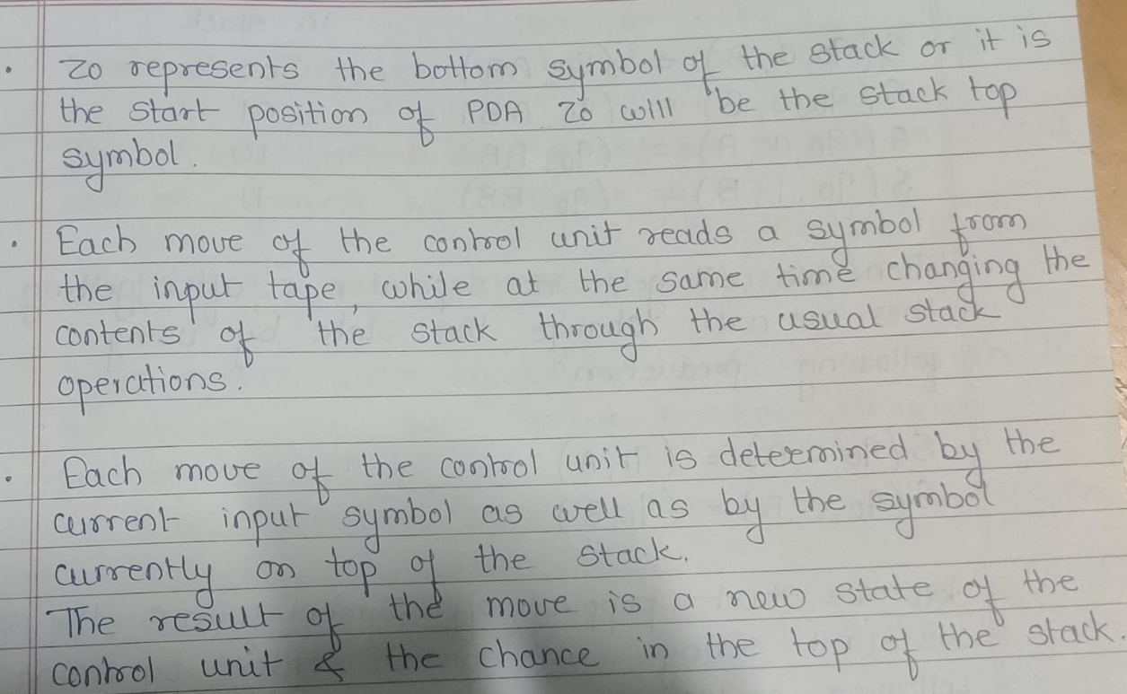

Slide 65
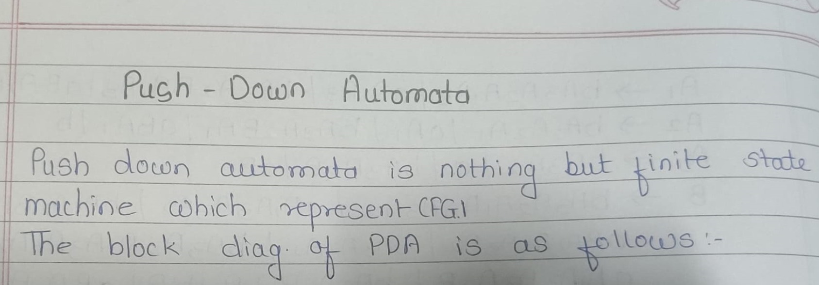
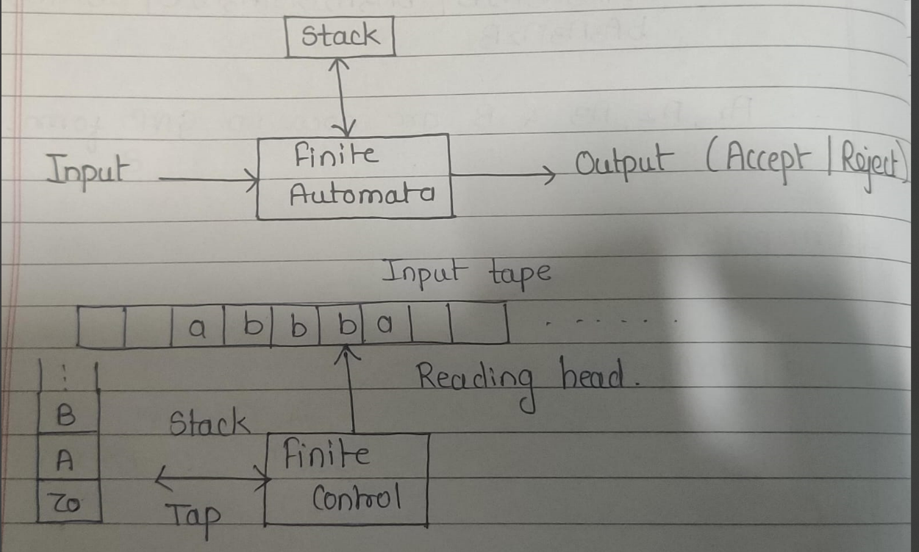

Slide 66
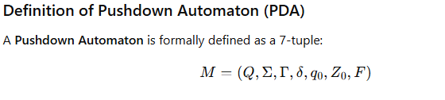
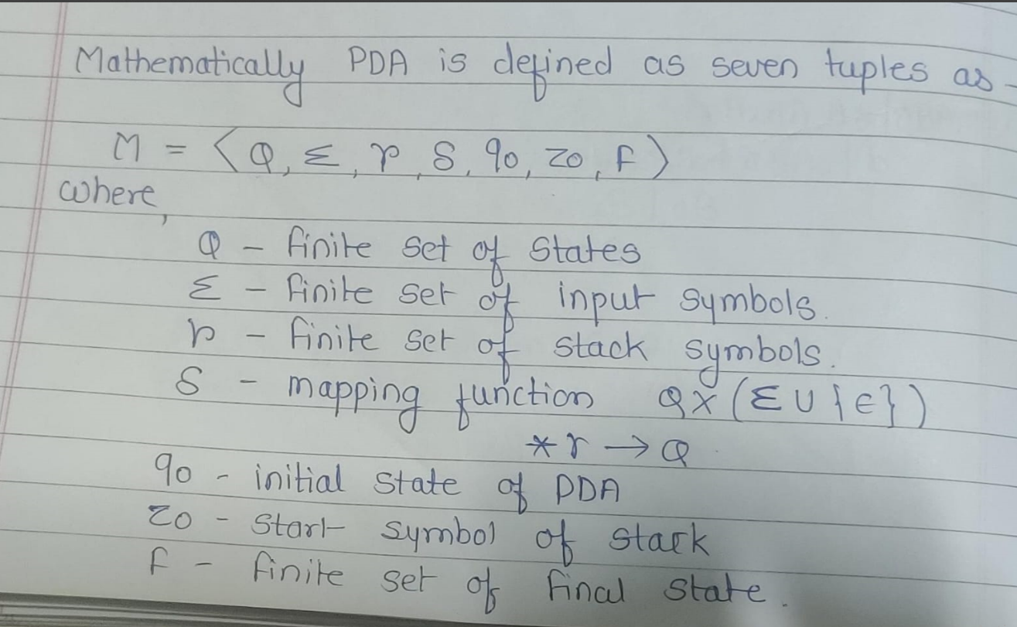

Slide 67
Construct a PDA for L(O^n 1^n) |n> 1

